Slide 1
Introduction to Cloud Computing
Lecturer: Ngo Huy Bien
Software Engineering Department
Faculty of Information Technology
University of Science
Ho Chi Minh City, Vietnam
nhbien@fit.hcmus.edu.vn

Slide 2

Objectives
To communicate in cloud computing field.

Slide 3

Contents
Clouds
Cloud Services
Cloud Computing
Cloud Deployment Models
Public Cloud Limitations
Cloud Software Engineering
Fog Computing

Slide 4

References
Frederick Chong and Gianpaolo Carraro (2006). Architecture Strategies For Catching The Long Tail.
Paul Hofmann (2010). Cloud Computing - The Limits of Public Clouds for Business Applications.
Michael Armbrust et al. (2009). Above the Clouds - A Berkeley View of Cloud Computing.
Borko Furht and Armando Escalante (Editors) (2010). Handbook of Cloud Computing.
Rajkumar Buyya et al. (2008). Market-Oriented Cloud Computing: Vision, Hype, and Reality for Delivering IT Services as Computing Utilities.
Peter Mell and Timothy Grance (2011). The NIST Definition of Cloud Computing.
Stephen S. Yau and Ho G. An (2011). Software Engineering Meets Services and Cloud Computing.
Gautam Shroff (2010). Enterprise Cloud Computing: Technology Architecture Applications. Cambridge University Press.
T. Dillon, C. Wu and E. Chang (2010). "Cloud Computing Issues and Challenges".
Hassan Takabi et al. (2010). Security and Privacy Challenges in Cloud Computing Environments.
Neal Leavitt (2009). Is Cloud Computing Really Ready for Prime Time.

Slide 5
Introduction
Computer: CPUs, RAM, Disks, NICs.
What to do: Browsing the web, watching videos, programming, editing images, videos.
What else: Running web servers 24/7/365, processing large amounts of data for a short time, computing large numbers for a short time, sharing files.
What we can do: Renting computers, sharing computers.
Our goals: To reduce costs, to eliminate the need for hardware maintenance, to rapidly acquire computing and storage capacity.

Slide 6
Cloud Services
Consumers: email and credit card.
Providers: web interface, servers.
IaaS (Infrastructure as a Service)
PaaS (Platform as a Service)
SaaS (Software as a Service)
Public clouds, private clouds, hybrid clouds.
Considerations: vendor lock-in, security.
Developing (Programming with cloud services, building cloud services)
Datacenters, cloud computing (tenants).
Grid computing (power), fog computing (IoT).

Slide 7
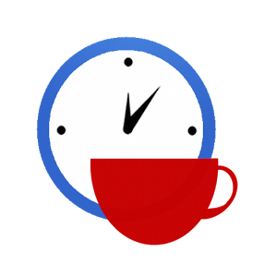

Slide 8
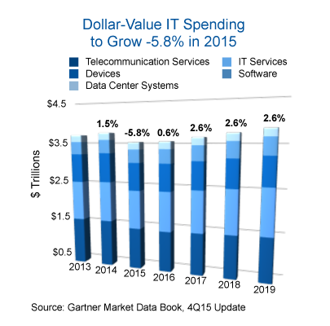
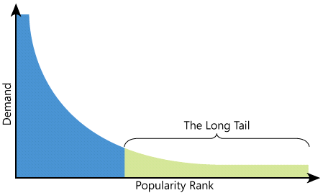

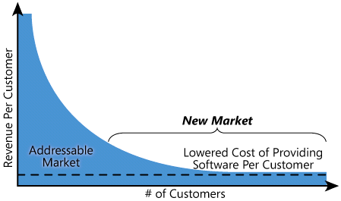
Enterprise IT Cost is Too High [1]
Notes:
Chi phí để xây dựng và vận hành các hệ thống này rất LỚN. Các doanh nghiệp nhỏ gần như KHÔNG có khả năng để sở hữu các hệ thống thông tin này.
Frederick Chong and Gianpaolo Carraro. Architecture Strategies For Catching The Long Tail. 2006.

Slide 9
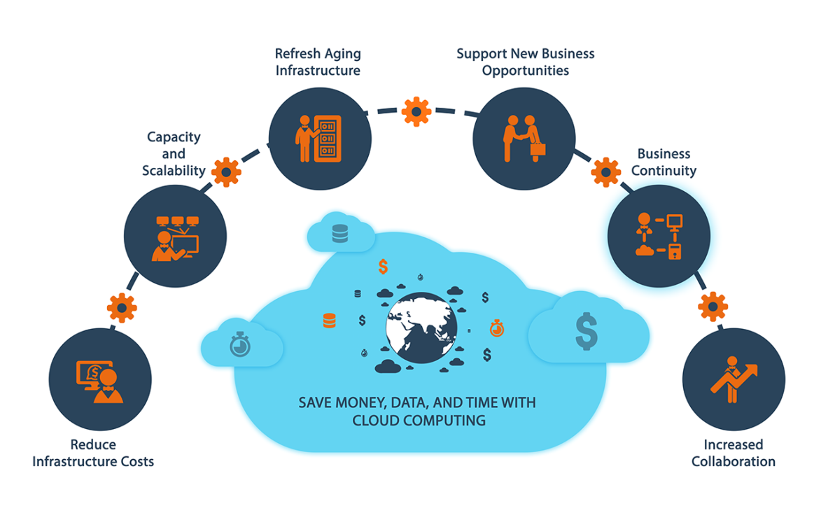
A Solution – Cloud Computing [2, 3]
The cloud model moves IT infrastructure from an upfront capital expense to an operational one.
Reduced time to market
Usage-based costing
Notes:
Điện toán đám mây hứa hẹn một cuộc cách mạng trong công nghệ và kinh doanh bằng cách cung cấp khả năng tính toán như các dịch vụ trong môi trường mạng toàn cầu (internet).
Việc cung cấp khả năng tính toán dạng dịch vụ hứa hẹn việc giảm chi phí đầu tư ban đầu để sở hữu một hệ thống công nghệ thông tin cho doanh nghiệp và thay vào đó là chi phí vận hành, đồng thời giảm thời gian đưa hệ thống vào ứng dụng.

Slide 10

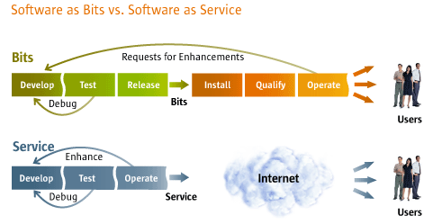
How Does Cloud Computing Reduce Time?
Notes:
Điện toán đám mây giảm thời gian xây dựng và chi phí vận hành do phần mềm được xây dựng sẵn, chỉ cần chỉnh sửa cho phù hợp với nhu cầu của khách hàng.
Khách hàng không tốn thời gian để xây dựng, cài đặt, kiểm thử hệ thống.

Slide 11
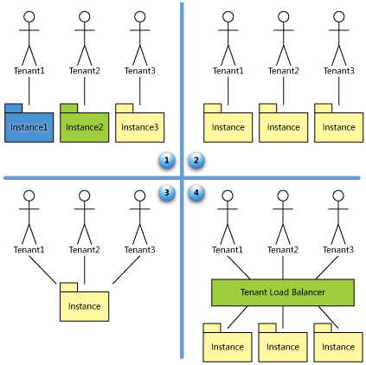

How Does Cloud Computing Reduce Cost [1]
Tenant: Corporate or Company or Individual
Ad Hoc/Custom
Configurable
Scalable, Configurable, Multi-Tenant-Efficient
Configurable, Multi-Tenant-Efficient
Notes:
Điện toán đám mây giảm chi phí sở hữu do chi phí xây dựng phần mềm được chia sẻ giữa nhiều khách hàng với nhau.
Đặc biệt chi phí sẽ giảm rất nhiều khi các khách hàng chia sẻ không chỉ chi phí xây dựng phần mềm mà cả chi phí phần cứng, chi phí vận hành và bảo trì phần mềm.

Slide 12
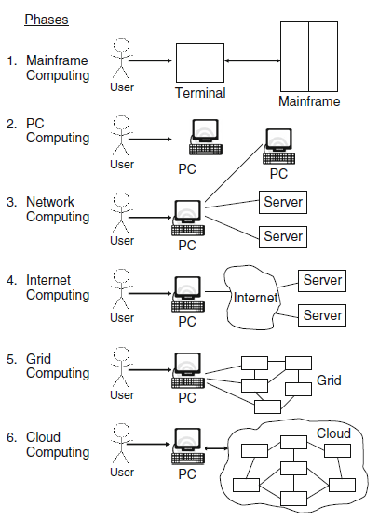
Computing Paradigms [4]
Terminals/Mainframes
PCs
Networking Computing
PCs, laptops, and servers were connected together through local networks to share resources and increase performance
Internet Computing
Local networks were connected to other local networks forming a global network such as the Internet to utilize remote applications and resources.
Grid Computing
Shared computing power and storage through a distributed computing system.
Cloud Computing
Shared resources on the Internet in a scalable and simple way.

Slide 13
What is Cloud? [6]
A cloud is a type of parallel and distributed system consisting of a collection of interconnected and virtualized computers that are dynamically provisioned and presented as one or more unified computing resources based on service-level agreements established through negotiation between the service provider and consumers.
A supercomputer with unlimited compute and storage.
On-demand access
Access from anywhere that has Internet access
On-demand cost

Slide 15
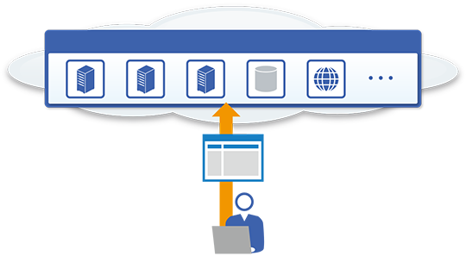
Cloud Providers and Clients [11]
Cloud-computing providers' infrastructures consists of
Clients generally use browsers or dedicated software to access cloud applications, which they frequently control via APIs.
Internet-connected servers, at one site or distributed across several locations, that house applications and data.
Virtualization, grid, management, database, and other types of software.
User interfaces, APIs, a communications infrastructure for connecting to users over the Internet or a private network.
A usage monitoring and billing mechanism.
Notes:
Neal Leavitt. Is Cloud Computing Really Ready for Prime Time. 2009.
Về mặt bản chất, điện toán đám mây có 2 đối tác chính: nhà cung cấp dịch vụ và khách hàng.

Slide 16
Infrastructure as a Service (IaaS)
The capability provided to the consumer is to provision processing, storage, networks, and other fundamental computing resources where the consumer is able to deploy and run arbitrary software, which can include operating systems and applications.
Example IaaS products and providers: Amazon Elastic Cloud Compute (EC2), IBM BlueHouse, VMWare, GoGrid, RightScale and Linode.
Notes:
Đối với người dùng, điện toán đám mây cung cấp 3 loại dịch vụ chính: IaaS, PaaS, SaaS.
Stephen S. Yau and Ho G. An. Software Engineering Meets Services and Cloud Computing. IEEE Computer Society. 2011.

Slide 17
Platform as a Service (PaaS)
The capability provided to the consumer is to deploy onto the cloud infrastructure consumer-created or acquired applications created using programming languages, libraries, services, and tools supported by the provider.
Example PaaS products and providers: Google App Engine, Heroku, Mosso, Force.com, Engine Yard, Amazon Simple Storage Service (S3), Eccentex's AppBase and Windows Azure are examples of.

Slide 18
Software as a Service (SaaS)
The capability provided to the consumer is to use the provider's applications running on a cloud infrastructure.
Example SaaS products and providers: Gmail, Hotmail, Quicken Online, IBM ® WebSphere, Boomi, SalesForce.com and Microsoft Office Online.

Slide 19
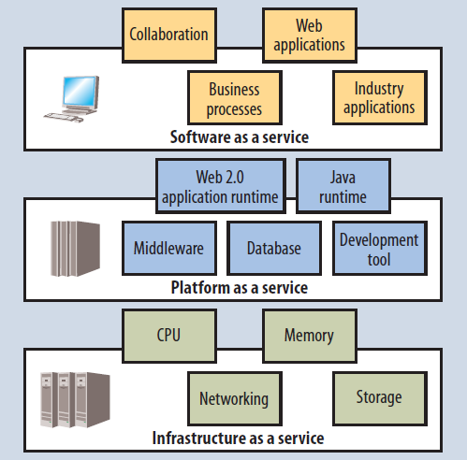
Holistic View of Services

Slide 20
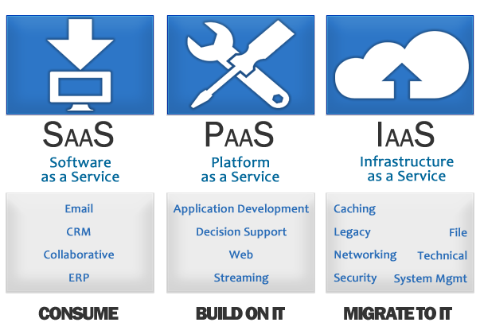
Services Users

Slide 21
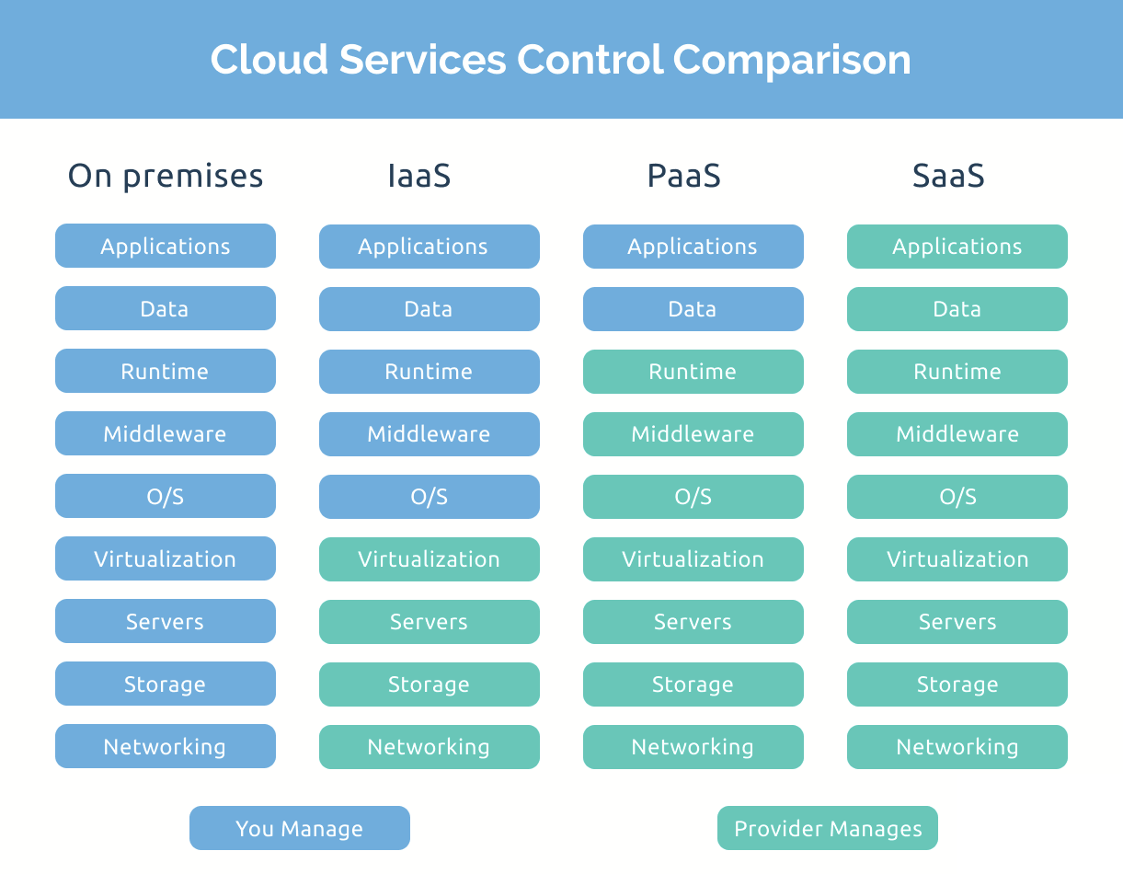
Cloud Services Control

Slide 22
Service-Level Agreements [3]
An SLA is a part of a service contract between the consumer and provider that formally defines the level of service.
It records a common understanding about services, priorities, responsibilities, guarantees, and warranties.
The main issue for cloud computing is to build a new layer to support a contract negotiation phase between service providers and consumers and to monitor contract enforcement.
Consumers might not completely trust measurements provided solely by a service provider, which might require agreed-upon third-party mediators to measure the SLA's critical service parameters and report violations.

Slide 23
Cloud Characteristics [7]
On-Demand Self-service. A consumer can unilaterally provision computing capabilities.
Broad Network Access. Capabilities are available over the network and accessed through standard mechanisms.
Rapid Elasticity. Capabilities can be elastically provisioned and released.
Measured Service. Resource usage can be monitored, controlled, and reported, providing transparency for both the provider and consumer of the utilized service.
Resource Pooling. The provider's computing resources are pooled to serve multiple consumers using a multi-tenant model.

Slide 24
What is Cloud Computing? [4, 5]
Cloud computing can be defined as a new style of computing in which dynamically scalable and often virtualized resources are provided as services over the Internet.
Cloud computing is a model for enabling convenient, on-demand network access to a shared pool of configurable computing resources (e.g., networks, servers, storage, applications, and services) that can be rapidly provisioned and released with minimal management effort or service provider interaction.

Slide 26
Cloud Deployment Models [7]
Private cloud. The cloud infrastructure is provisioned for exclusive use by a single organization comprising multiple consumers (e.g., business units).
Community cloud. The cloud infrastructure is provisioned for exclusive use by a specific community of consumers from organizations that have shared concerns.
Public cloud. The cloud infrastructure is provisioned for open use by the general public.
Hybrid cloud. The cloud infrastructure is a composition of two or more distinct cloud infrastructures (private, community, or public) that remain unique entities, but are bound together by standardized or proprietary technology that enables data and application portability.

Slide 27
Public vs. Private Cloud [3]
A first case is when demand for a service varies with time.
Provisioning a data center for the peak load it must sustain a few days per month leads to underutilization at other times, for example.
Instead, Cloud Computing lets an organization pay by the hour for computing resources, potentially leading to cost savings even if the hourly rate to rent a machine from a cloud provider is higher than the rate to own one.
A second case is when demand is unknown in advance.
For example, a web startup will need to support a spike in demand when it becomes popular, followed potentially by a reduction once some of the visitors turn away.
Finally, organizations that perform batch analytics can use the "cost associativity" of cloud computing to finish computations faster: using 1000 EC2 machines for 1 hour costs the same as using 1 machine for 1000 hours.

Slide 28
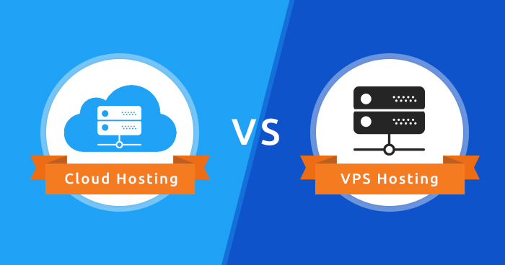
Cloud vs. Traditional Hosting [8]
The degree of automation made available to end-users, as web services, to control the number of virtual instances running at any point in time.
The ability for users to package and save their own configurations of virtual machines.
Charging per hour of actual usage as opposed to the monthly or yearly charges for traditional hosting.

Slide 29
Cloud vs. Service-Oriented Computing [9]
SOC represents a high level of abstraction from the integration and business process perspective.
However, SOC does not provide a practical computational models for running services.
How to run my services with minimum cost?
How to scale in/out my applications built on top of Service-Oriented Architecture?
How to maximize the utilization of my IT services in order to support my business services?

Slide 30
Cloud vs. Grid Computing
Cloud and Grid Computing both aim to achieve resource virtualization.
However, they do have significant differences:
Grid aims to provide the maximum computing capacity for a huge task through resource sharing. Cloud aims to suffice as many small-to-medium tasks as possible based on users' real-time requirements.
Grid trades re-usability for (scientific) high performance computing. Cloud computing is directly pulled by immediate user needs driven by various business requirements.

Slide 32
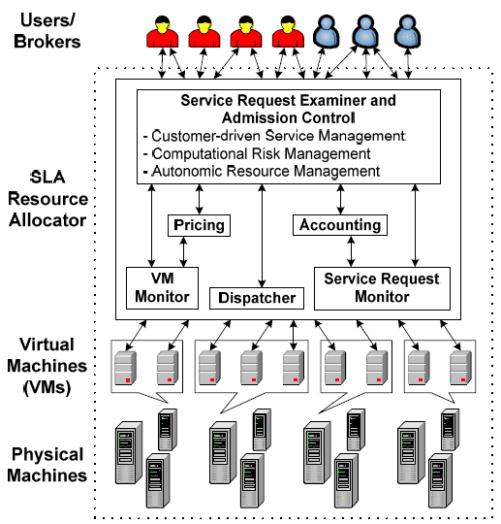

Market-Oriented Cloud Architecture [5]

Slide 33
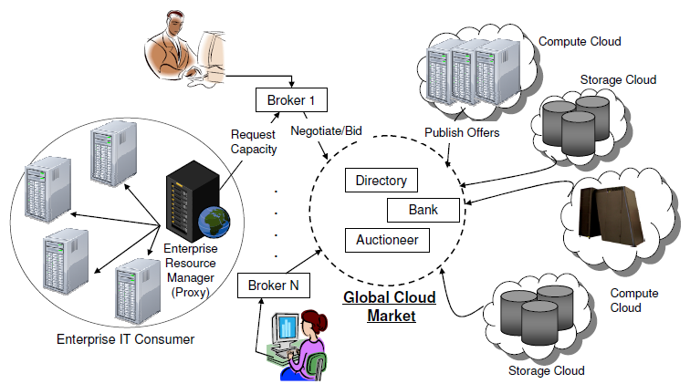
Global Cloud Exchange and Markets

Slide 34
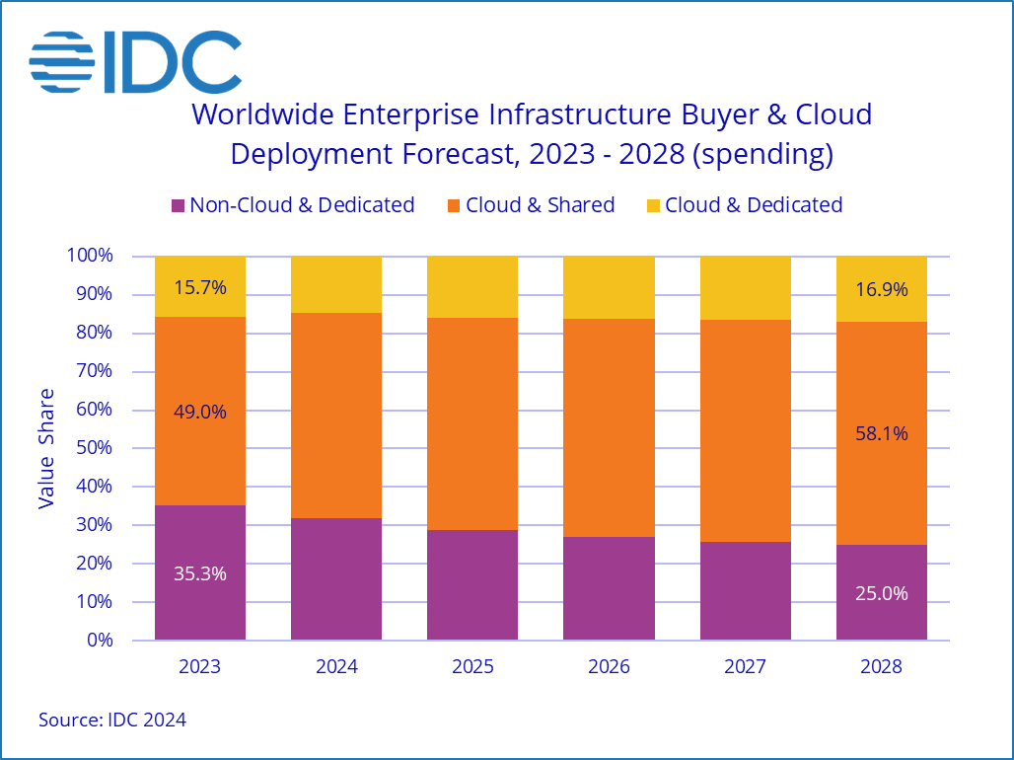
Cloud Spending Trends
https://my.idc.com/getdoc.jsp?containerId=prUS52460024
Worldwide spending on public cloud services is forecast to reach $805 billion in 2024 and double in size by 2028, according to the latest update to the International Data Corporation (IDC) Worldwide Software and Public Cloud Services Spending Guide.
Although annual spending growth is expected to slow slightly over the 2024-2028 forecast period, the market is forecast to achieve a five-year compound annual growth rate (CAGR) of 19.4%.

Slide 35
The Limits of Public Cloud (I) [2, 3]
Security and Privacy
Behind the firewall, enterprises have control of their data. In the cloud, they must trust the provider.
Most providers find it hard, if not impossible, to meet standards for auditability and comply with legislation.
Control
The providers generally don't design platforms to support specific companies' IT and business practices.
Users can't change the platform's technology when they want.

Slide 36
The Limits of Public Cloud (II)
Performance, Latency, Reliability and Related Bandwidth Costs
Customers who are a long distance from cloud providers could experience latency.
As applications make ever-more intense use of large volumes of data, data transfer poses an increasing bottleneck.
Higher network-bandwidth charges.
Broadband Internet connections aren't available in all places.

Slide 37
The Limits of Public Cloud (III)
Interoperability, Portability, Migration and Vendor Lock-In
Cloud providers offer different software frameworks.
All the major providers offer unique, and often proprietary, data storage.
No Scalable Storage (No simple generic solution for distributed data storage).
Exchanging data between different cloud providers is exacerbated by the network's limitations.

Slide 38
A Standardized Approach to Security for the Cloud
https://www.fedramp.gov/
The Federal Risk and Authorization Management Program (FedRAMP) is a government-wide program that provides a standardized approach to security assessment, authorization, and continuous monitoring for cloud products and services.
FedRAMP created and manages a core set of processes to ensure effective, repeatable cloud security for the government.
FedRAMP established a mature marketplace to increase utilization and familiarity with cloud services while facilitating collaboration across government through open exchanges of lessons learned, use cases, and tactical solutions.

Slide 40
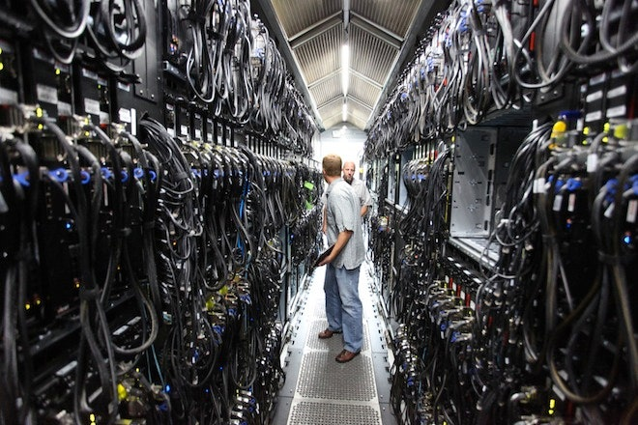
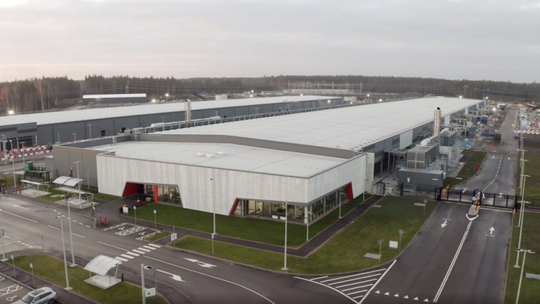
How to Build a Cloud
Big data storage
Big data processing
Multi-tenancy
Scalability
Fault tolerance
Asynchrony
Concurrency

Slide 42
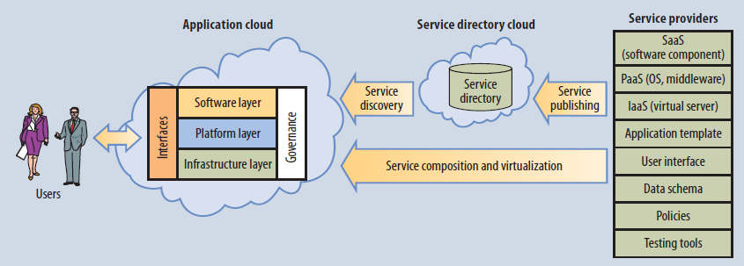
Cloud Software Engineering [7]
Service providers publish their services to a federated cloud directory.
Application developers discover and compose the services to build an application, which is delivered to users through the cloud.

Slide 43
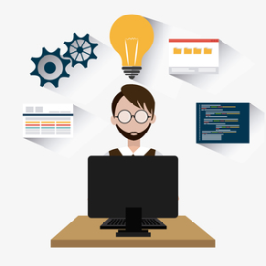
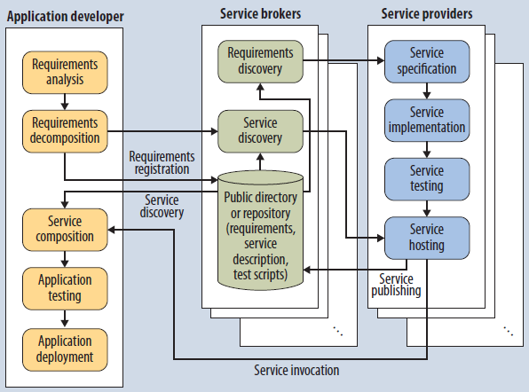
Cloud Software Engineering Process
From the service providers' view, service development is similar to what happens in other software development processes, except that services must also comply with standard protocols and interfaces.

Slide 45
Cloud-Based Software Development
Cloud-based software development
SaaS applications
Big data storage and processing
Security
Scalability
IaaS applications
PaaS applications
Federation
Multi-tenancy
Architecture
Variability
Integration
Enterprise service bus
Standards

Slide 47
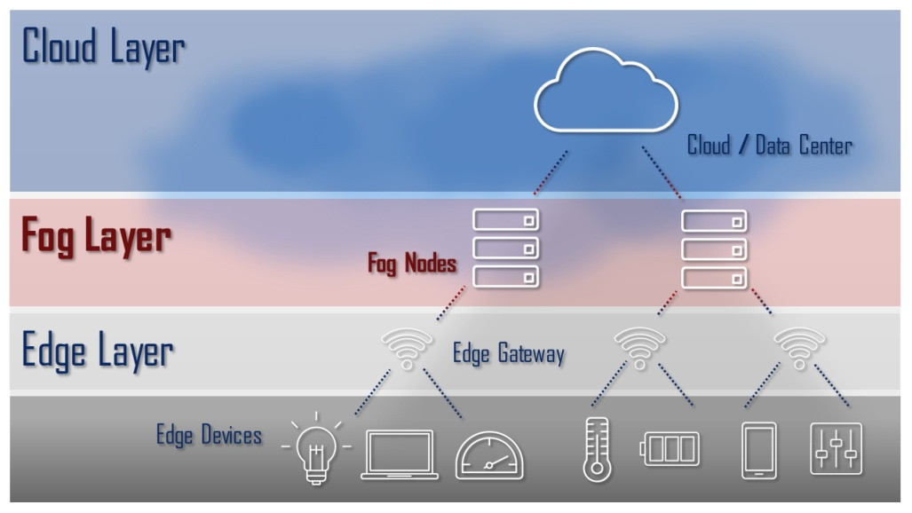
Fog Computing
Flavio Bonomi et al. (2012). Fog Computing and Its Role in the Internet of Things.
Fog computing is a highly virtualized platform that provides compute, storage, and networking services between end devices and traditional cloud computing data centers, typically, but not exclusively located at the edge of network.
Fog layer: Platform to deliver a rich portfolio of new services and applications at the edge of the network.

Slide 48
Examples
AWS IoT Greengrass
https://aws.amazon.com/greengrass/
Azure IoT Edge
https://azure.microsoft.com/en-us/products/iot-edge/
Google Distributed Cloud
https://cloud.google.com/distributed-cloud

Slide 49
Why Fog Computing?
Cloud computing frees the enterprise and the end user from the specification of many details.
This bliss becomes a problem for latency-sensitive applications, which require nodes in the vicinity to meet their delay requirements.
An emerging wave of Internet deployments, most notably the Internet of Things (IoTs), requires mobility support and geo-distribution in addition to location awareness and low latency.
Compute, storage, and networking resources are the building blocks of both the Cloud and the Fog.

Slide 50
Fog Computing vs. Private Cloud
Aspect | Fog Computing | Private Cloud
Definition | A decentralized computing paradigm that extends cloud services to the network edge, bringing computation, storage, and control closer to data sources (IoT devices). | A dedicated cloud infrastructure operated exclusively for one organization, hosted either on-premises or by a third party.
Primary Goal | Reduce latency and bandwidth use by processing data near the source. | Provide control, privacy, and compliance over data and resources within a closed cloud environment.
Architecture | Hierarchical and distributed: edge → fog → cloud layers. | Centralized or semi-centralized: internal data centers interconnected by virtualized infrastructure.
Resource Location | Located at or near network edges — e.g., routers, gateways, IoT nodes. | Located in centralized, secure data centers owned or managed by the organization.
Key Technologies | Edge analytics, virtualization on gateways, local orchestration, latency-sensitive IoT applications. | Virtualization, hypervisors (VMware, KVM), orchestration (OpenStack, Kubernetes), data governance.
Typical Use Cases | Smart cities, autonomous vehicles, industrial IoT, real-time healthcare monitoring. | Financial systems, government data centers, regulated healthcare, enterprise workloads.
Latency Sensitivity | Very low latency (milliseconds) critical for IoT control loops. | Moderate latency acceptable; network delay is higher than fog.
Connectivity Dependence | Operates even with intermittent cloud connection (local decisions). | Generally requires continuous connectivity within the organization’s network.
Scalability | Scales horizontally across distributed nodes. | Scales vertically or via data center expansion.

Slide 51

Further Reading
Dan C. Marinescu (2022). Cloud Computing: Theory and Practice. Morgan Kaufmann.
Thomas Erl and Eric Barcelo Monroy (2023). Cloud Computing: Concepts, Technology, Security & Architecture. Pearson.

Slide 52

Thank You & See You Again

